Slide 1
SMART PARKING
SUBMITTED BY
T.KAVI BHARATH
auttrtkvl004(transfer)
kavibharath06112002@gmail.com
Department of Electronics and Communication Engineering Anna University Regional Campus – Coimbatore.

Slide 2
POSSIBLE SOLUTIONS
IoT-Enabled Parking Spots:
Design a system where parking spots themselves are equipped with IoT sensors. These sensors can detect when a vehicle is parked and communicate with a centralized system to update real-time parking availability.
Dynamic Pricing Model:
Develop a dynamic pricing model that adjusts parking fees based on demand and occupancy. This could encourage users to park during off-peak hours, reducing congestion during busy times.

Slide 3
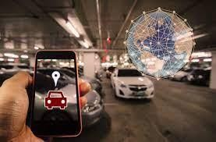
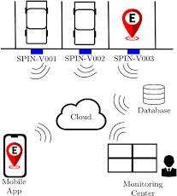

Slide 4
POSSIBLE SOLUTIONS cont....
AI-Powered Parking Guidance:
Implement artificial intelligence to provide real-time parking guidance. This can help drivers find available parking spots quickly and reduce the time spent searching for a space.
Reservation System:
Create a reservation system for parking spaces, allowing users to book a spot in advance, similar to how you would reserve a table at a restaurant. This can save time and reduce frustration.

Slide 5
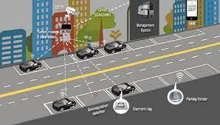

Slide 6
POSSIBLE SOLUTIONS cont...
Automated Valet Parking:
Explore the concept of automated valet parking, where vehicles are automatically parked by a robotic system. This can maximize parking space usage and improve convenience.
Integration with Public Transportation:
Develop a system that integrates with public transportation services, providing information on parking availability at transit stations and encouraging the use of public transport.

Slide 7
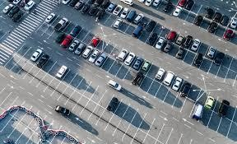

Slide 8
POSSIBLE SOLUTIONS conti...
Green Parking Solutions:
Design parking facilities with eco- friendly features, such as solar panels, electric vehicle charging stations, and rainwater harvesting for sustainable landscaping.
Augmented Reality Parking Assistance:
Create an augmented reality app that helps drivers navigate to available parking spaces with visual overlays on their smartphone screens.

Slide 9
PROPOSED SOLUTION
Reservation based dynamic spot model :
The model proposed here under would have the reservation based mechanism for parking the slot also it charges based on the time limit or periods and iot enabled parking sensors can detect when a vehicle is parked and communicate with a centralized system to update real- time parking availability.

Slide 10
Proposed solution cont...
This system would adjust parking fees based on factors such as real-time demand, location, and time of day. By encouraging users to consider alternative parking options during peak times or in high-demand areas, it can help reduce congestion and optimize parking space utilization.
While also providing a potential revenue source for cities or parking operators.
This can help drivers find available parking spots quickly and reduce the time spent searching for a space.

Slide 11
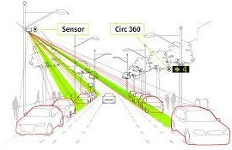

Slide 12
THANK YOU

